Slide 1
R session 1: Basics of R
Nick Cohort

Slide 2

Resources
Welcome | R for Data Science (had.co.nz)
Book and website – good for approaching R in a data science way
R Tutorial - Learn R Programming (datamentor.io)
Good for general advice and specific examples of functions
Programming with R (swcarpentry.github.io)
Takes you through the analysis of a scientific experiment
YaRrr! The Pirate’s Guide to R (bookdown.org)
Very useful if you can deal with the pirate puns

Slide 3

Getting help in R
Help on specific topics
help(Syntax)
?Syntax
Help on general topics
help.search(“Syntax”)
??”Syntax”

Slide 4
Basics
You can use R as a calculator
Creating objects is one of the most important things to remember about R – like algebra
Not suggested to use “=“ as that can mean other things in code

Slide 5
Packages in R
Packages are collections of R functions, compiled code and example data. Anyone can create a package and store them for external access in a repository.
Most common repositories are CRAN, Bioconductor, and Github
Best way to know which packages you needs is to use R – otherwise can visit CRAN to read about available packages for your workstream
Searching for a package in google will bring up vignettes with details of the packages
Important packages
tidyr
ggplot2
dplyr
MASS

Slide 6
Entering data into R
Data in excel can be imported into R. There are two common ways to do this
read.csv (automatic package) Reading and Writing CSV Files – Programming with R (swcarpentry.github.io)
Data needs to be in comma delimited format
read.xlsx (package xlsx)
Data can be in a normal excel format and can read individual tabs easily

Slide 7
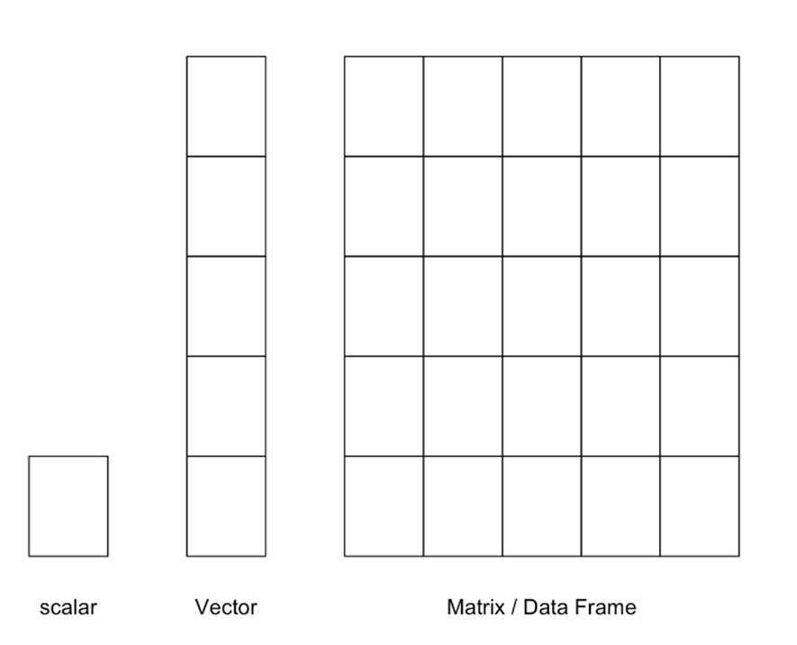
Data types in R
Vector
Simplest data structure in R where elements in the vector are all the same type
Matrix
2D array of numbers – can only contain one type of data
List
Ordered collection of objects that contain values of different types
Dataframe
Similar to a matrix, composed of rows and columns with the columns considered vectors
To create use as.data.set

Slide 8
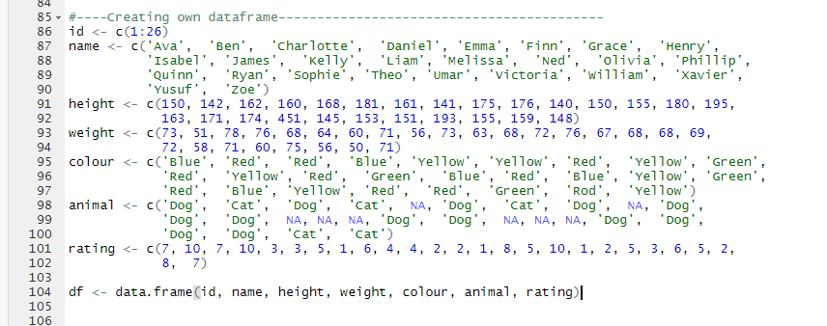
Creating your own dataset
We can now create our own dataset by combining what we know about data types and inserting our numbers into a dataframe.
In R this is easiest to create multiple vectors and then combine these into a dataset

Slide 9
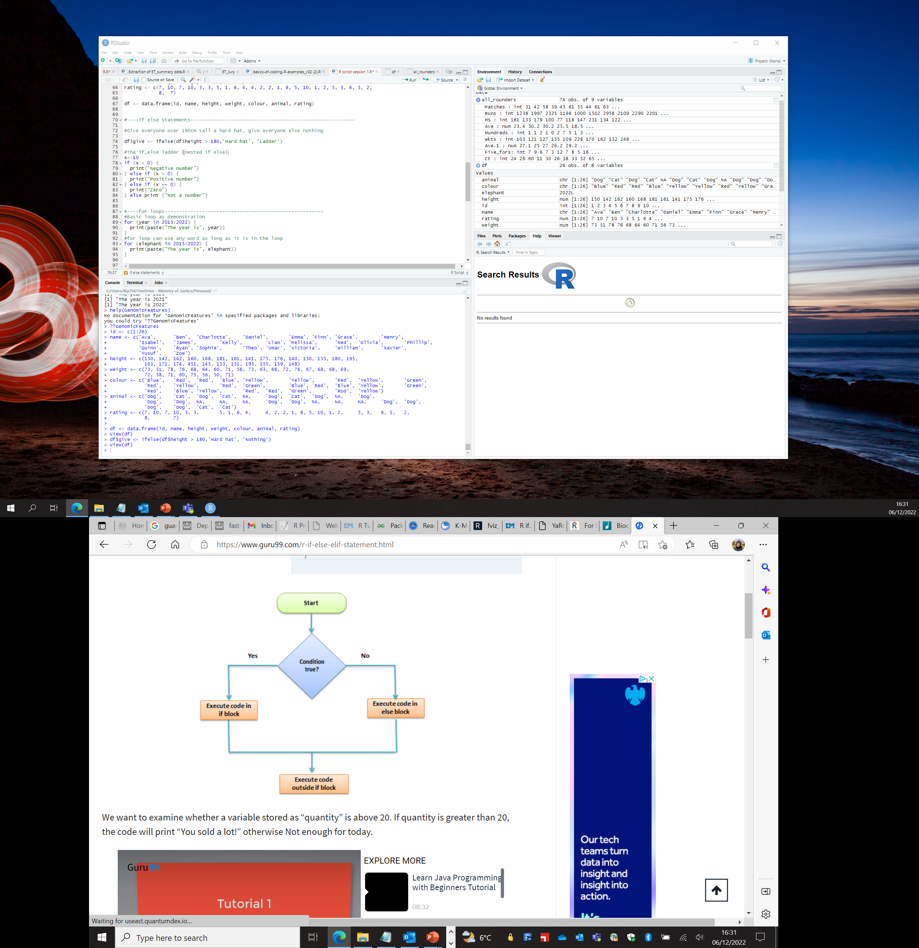
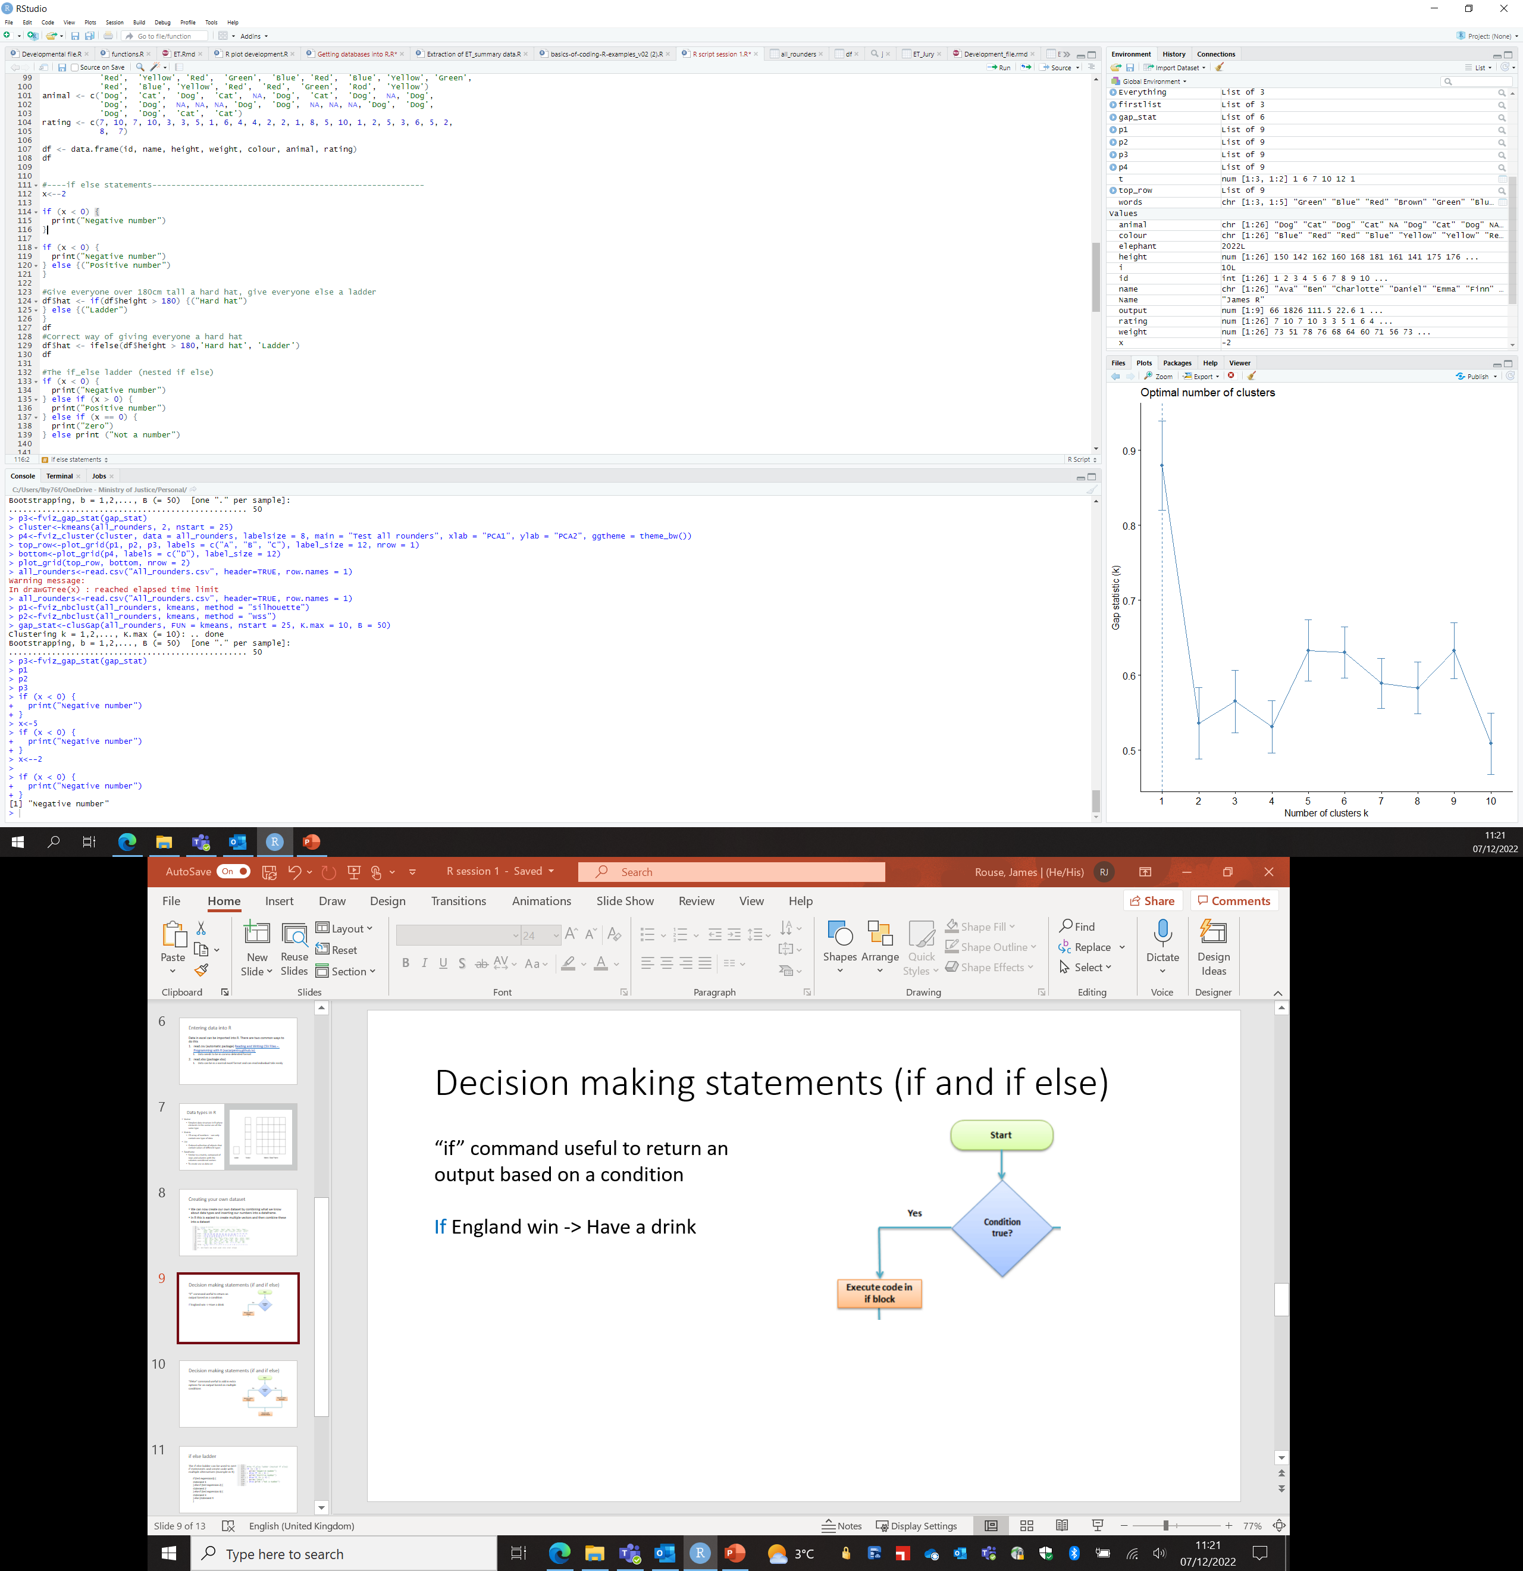
Decision making statements (if and if else)
“if” command useful to return an output based on a condition
If England win -> Have a drink

Slide 10
Decision making statements (if and if else)
“ifelse” command useful to add in extra options for an output based on multiple conditions

Slide 11
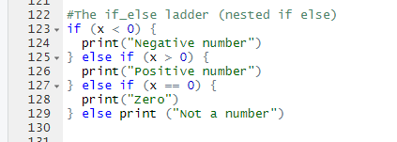
if else ladder
The if else ladder can be used to nest if statements and create code with multiple alternatives (example in R)
if (test expression1) {
statement 1
} else if (test expression 2) {
statement 2
} else if (test expression 3) {
statement 3
} else (statement 4)

Slide 12
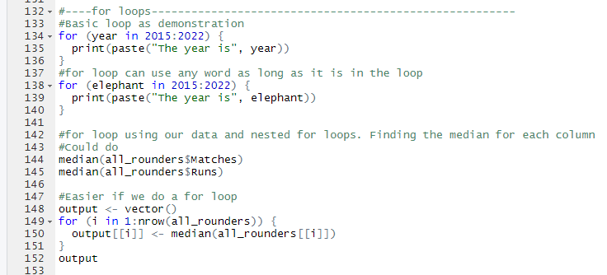
for loops
Repeating chunks of code that will reiterate with different values for every run of the loop
For large datasets try to avoid as there is a risk of an infinity loop
Syntax is always…
for (variable in sequence) {
expression
}
Blue words are compulsory

Slide 13
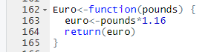
Functions
Functions can be thought of as short cuts for larger pieces of code
Define by using function {}
Can combine functions within functions (very meta) to create useful shortcuts for everyday analysis and automate analysis
Creating Functions – Programming with R (swcarpentry.github.io)

Slide 14
More exciting stuff in R
K-means clustering and simple data science
Here, using K-means clustering to understand how all-rounders (cricket) compare to their contemporaries
Objective of k-means is to group similar data points together and discover underlying patterns in the data
K-means Cluster Analysis · UC Business Analytics R Programming Guide (uc-r.github.io)

